Slide 1


TensorFlow @UST
Day 1
Sung Kim

Slide 2



Gifts from Google and Line

Slide 3
TensorFlow @UST
Day 1
Sung Kim

Slide 4
Shocking IT NEWS last years?

Slide 5
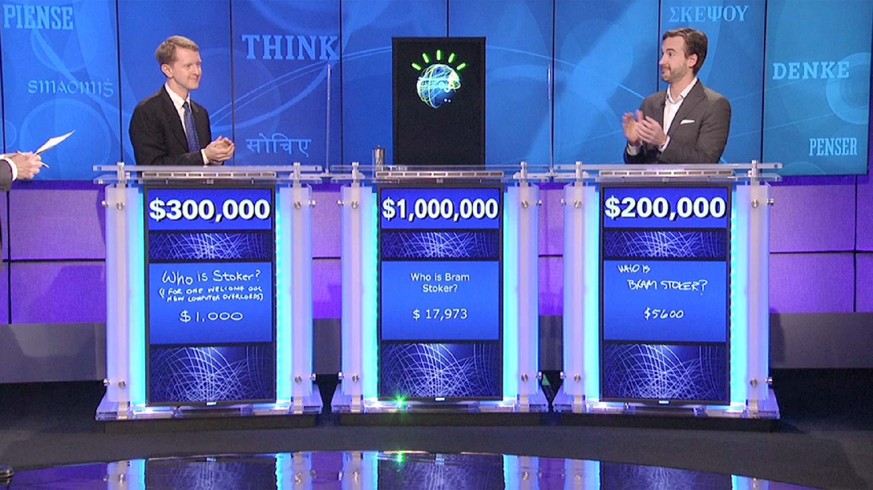

Slide 6
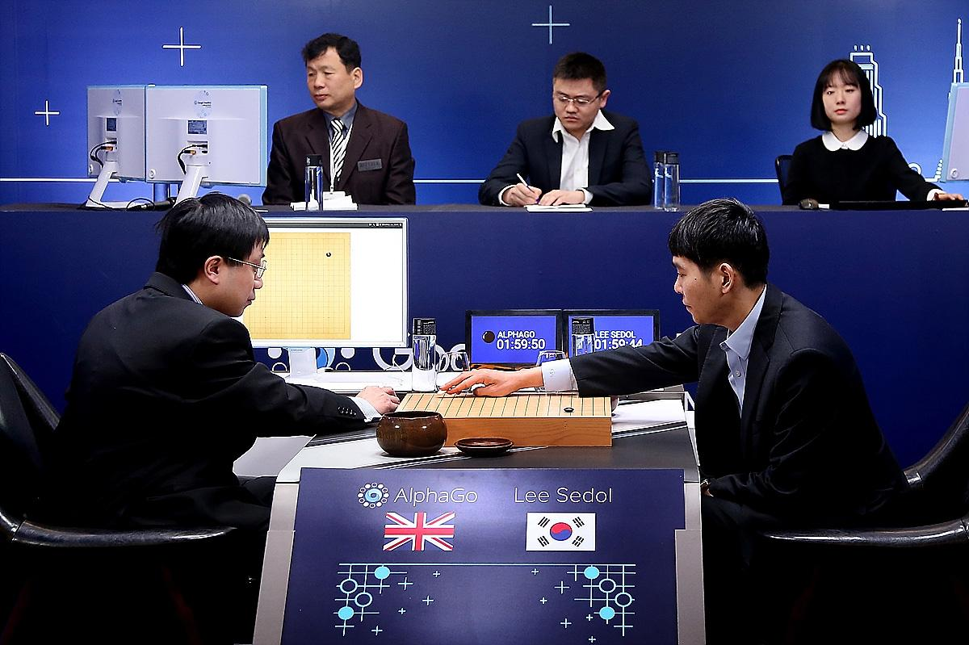

Slide 7


Slide 8
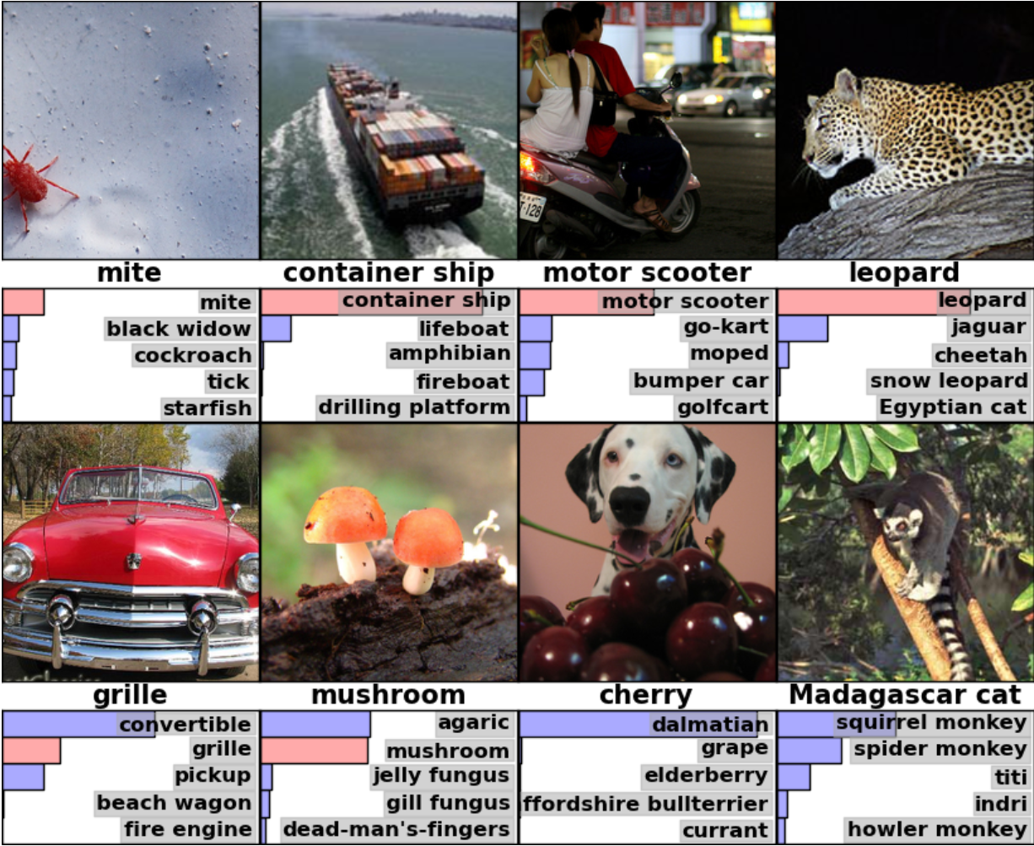

Slide 9
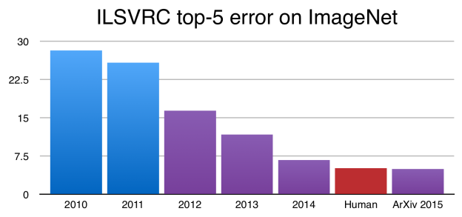
https://devblogs.nvidia.com/parallelforall/page/5/

Slide 10
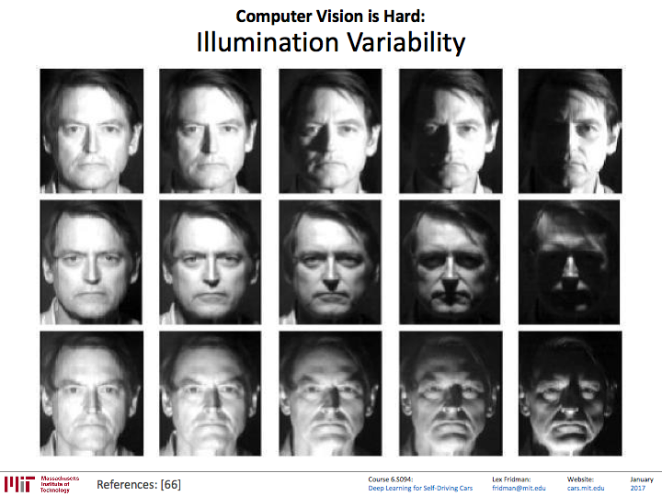

Slide 11
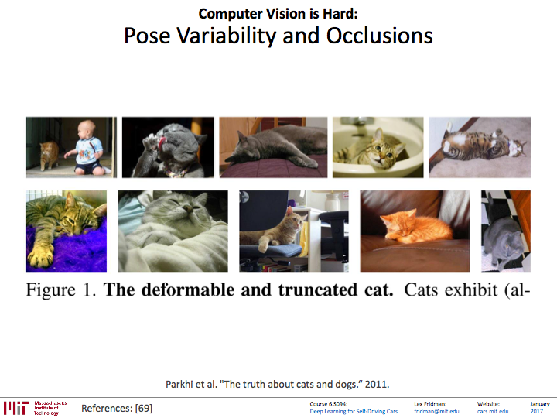

Slide 12
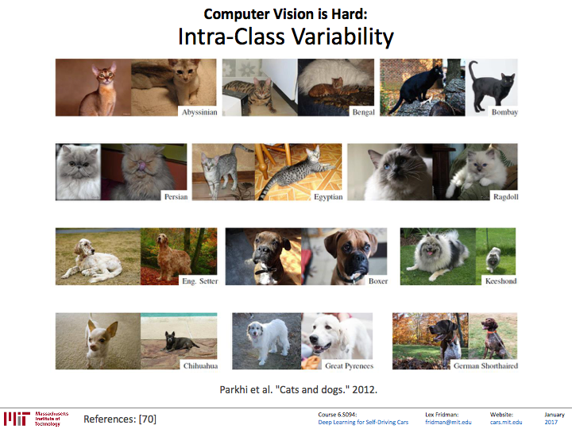

Slide 13
https://devblogs.nvidia.com/parallelforall/page/5/

Slide 14


http://respondr.io/7-ways-machine-learning-is-already-affecting-your-world/

Slide 15
Machine Learning is
Already Affecting Your World
http://respondr.io/7-ways-machine-learning-is-already-affecting-your-world/

Slide 16
如果要建造一艘船，不要一起鼓勵人們收集木材，
不要分配任務和工作，
而應該教他們漫長的海洋無限遠。

Slide 17
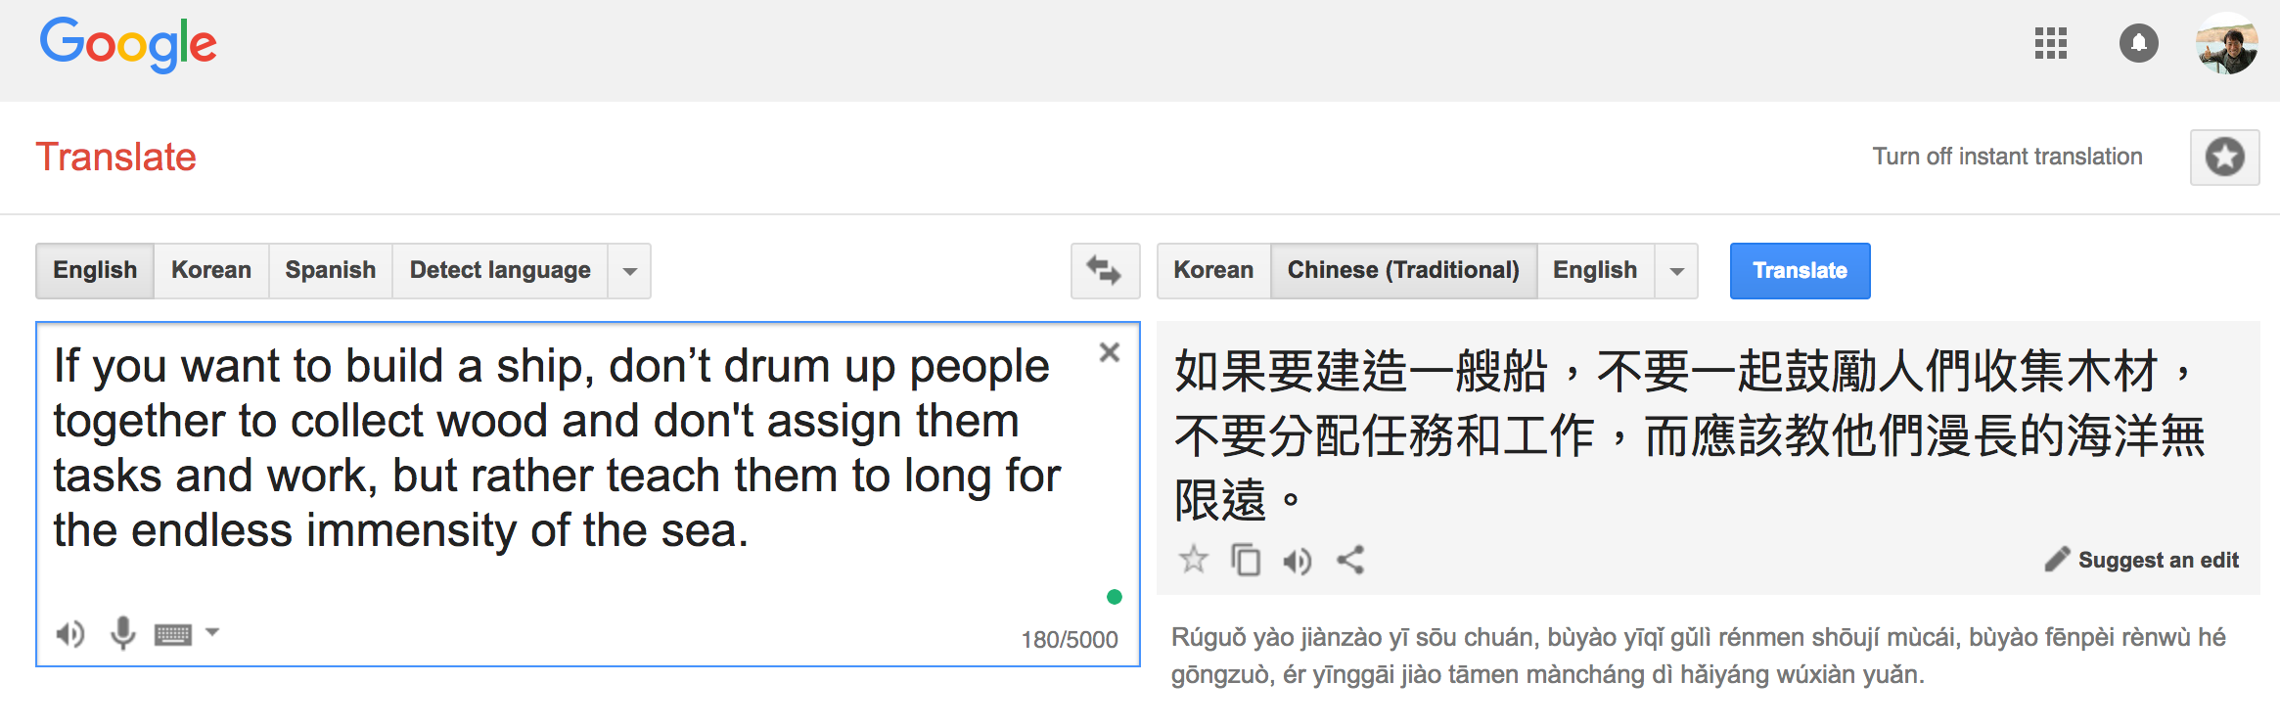
Notes:
For live demo with the different language:
"If you want to build a ship, don't drum up people together to collect wood and don't assign them tasks and work, but rather teach them to long for the endless immensity of the sea."

Slide 18
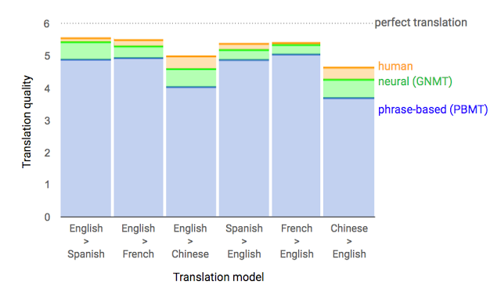
Google Neural Machine Translation (Sep 2016)
[Reference] "A Neural Network for Machine Translation, at Production Scale", https://research.googleblog.com/2016/09/a-neural-network-for-machine.html

Slide 19

https://play.google.com/store/apps/details?id=com.baidu.research.talktype&hl=en

Slide 20

https://play.google.com/store/apps/details?id=com.fitnow.loseit&hl=en

Slide 21
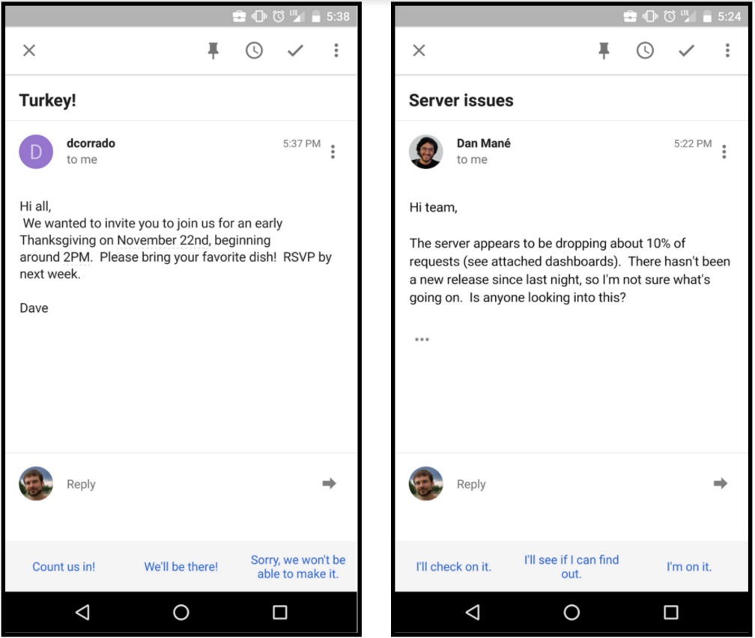
Smart Reply: Promising results
Seen 78%, Used 31.9%
http://www.kdd.org/kdd2016/papers/files/Paper_1069.pdf

Slide 22

https://www.autodraw.com/

Slide 23
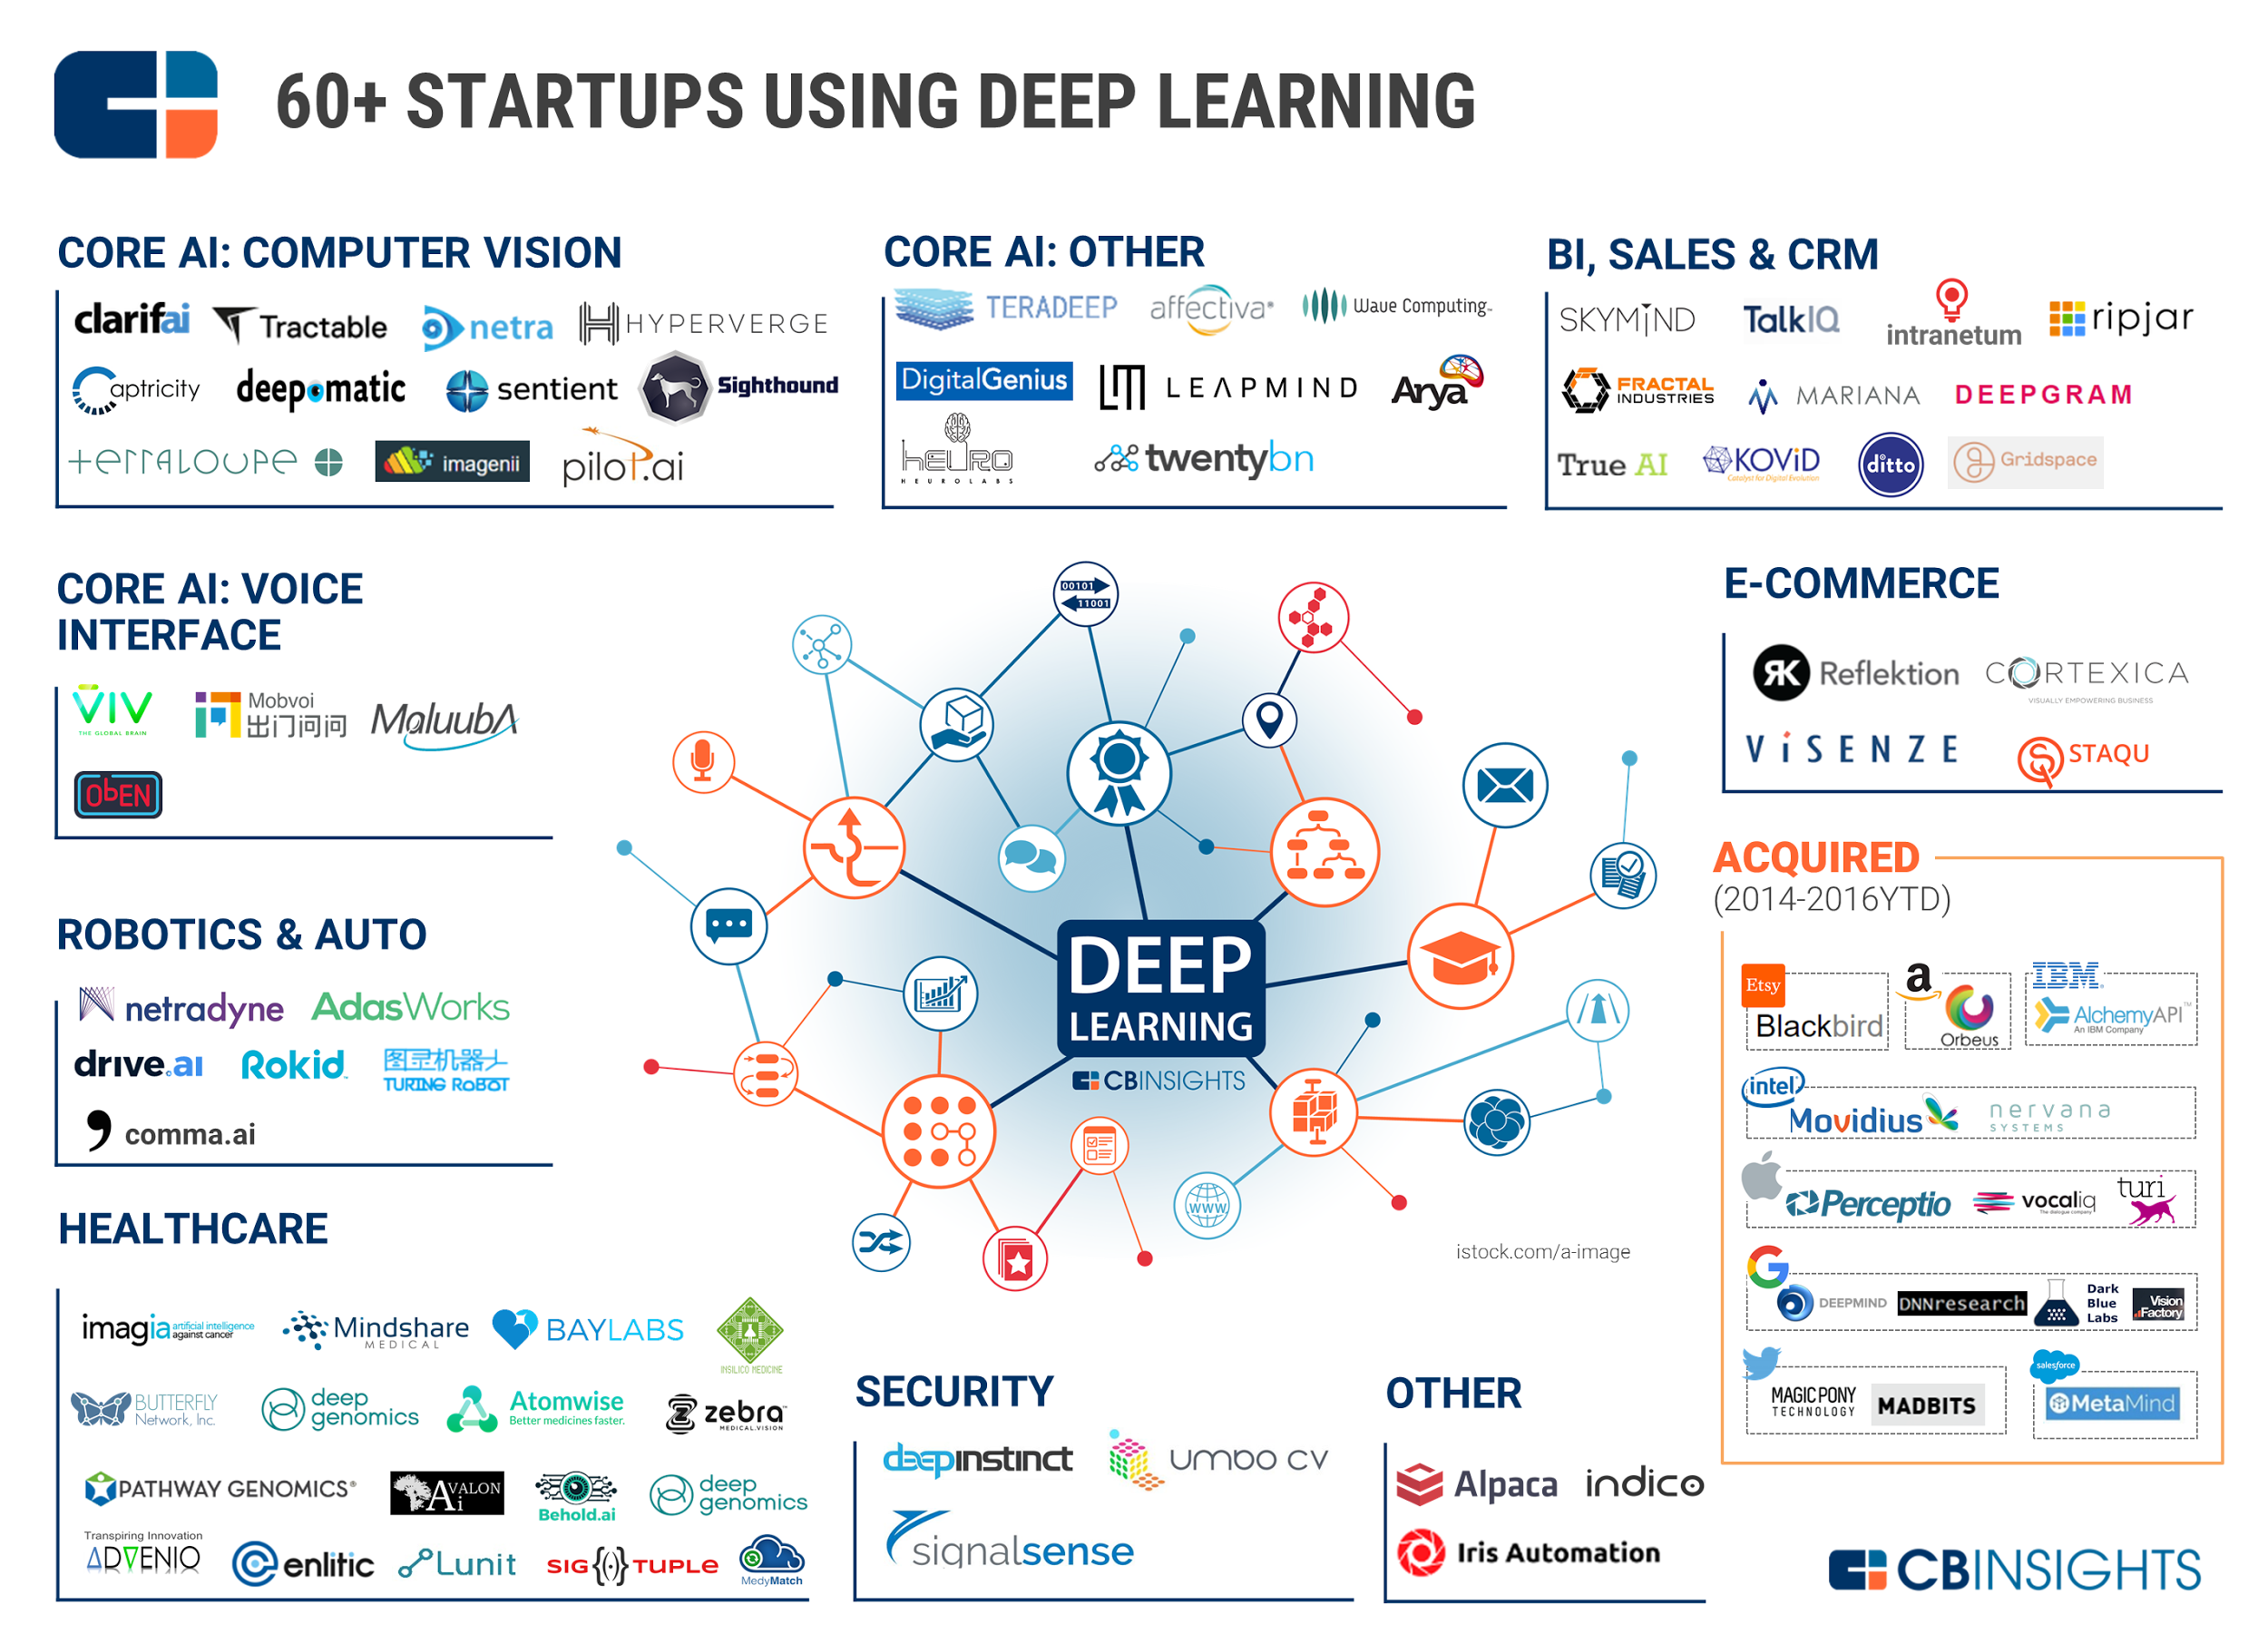
https://www.cbinsights.com/blog/deep-learning-ai-startups-market-map-company-list/

Slide 24

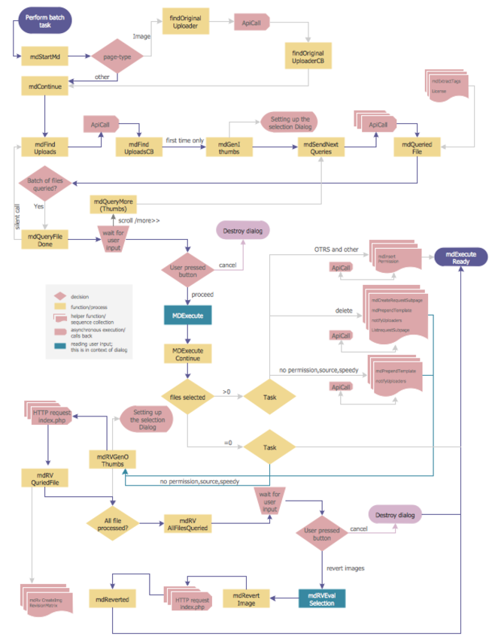


Rule based programming VS data driven learning

Slide 25


How can we develop?

Slide 27
Smart Reply: Promising results
Seen 78%, Used 31.9%
http://www.kdd.org/kdd2016/papers/files/Paper_1069.pdf

Slide 28
Rule based programming VS data driven learning

Slide 29





Slide 30

https://www.tensorflow.org

Slide 31
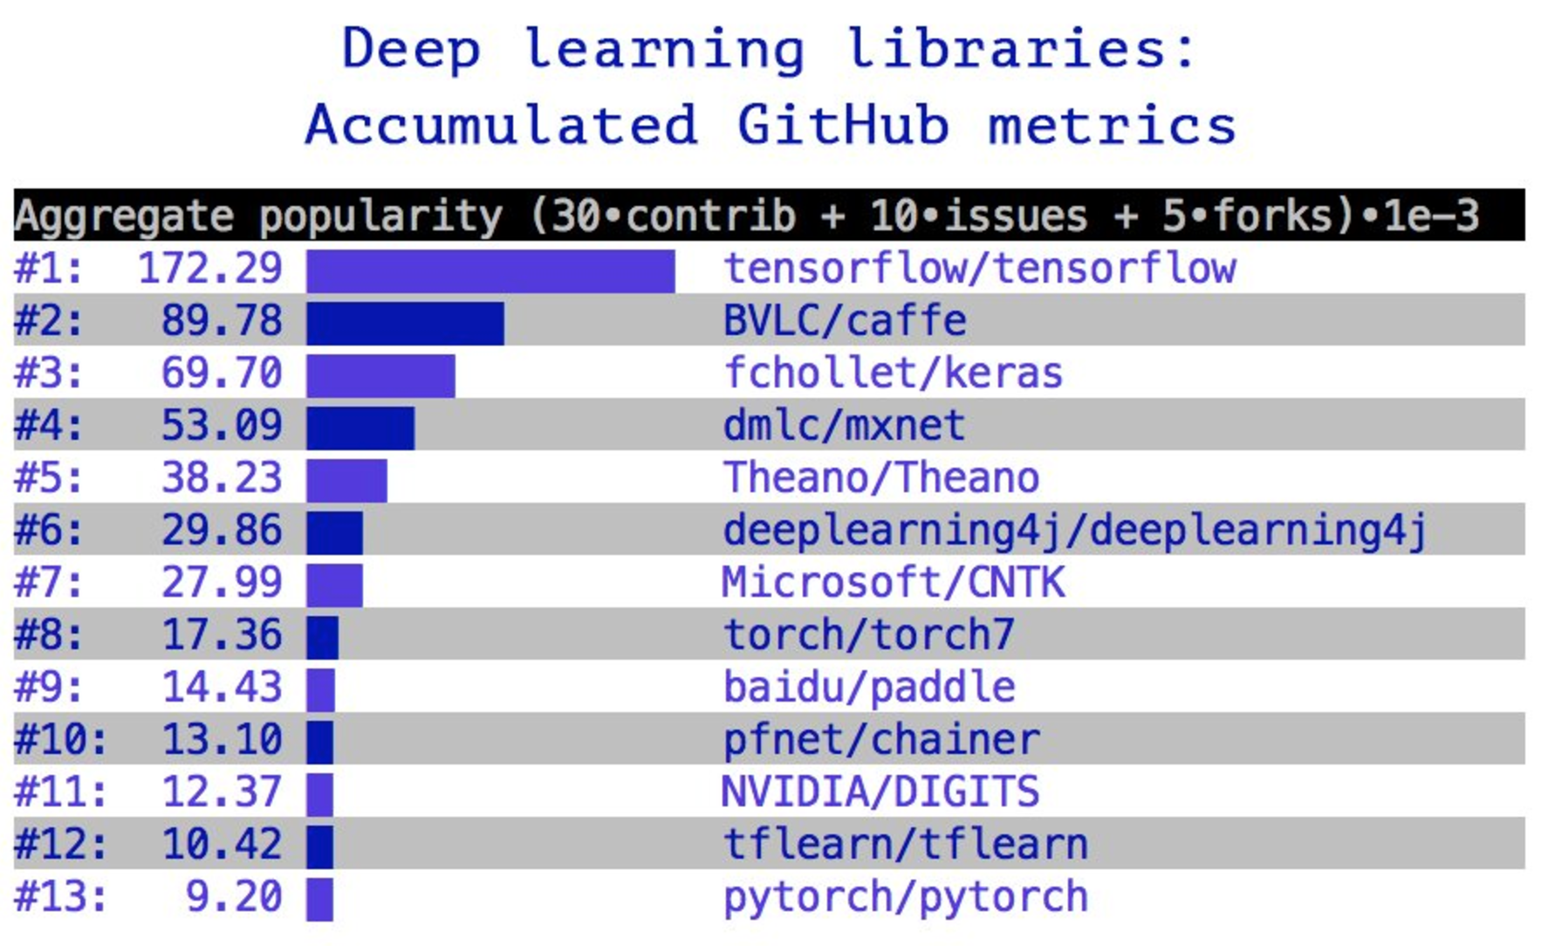
TensorFlow
https://twitter.com/fchollet/status/830499993450450944/

Slide 32
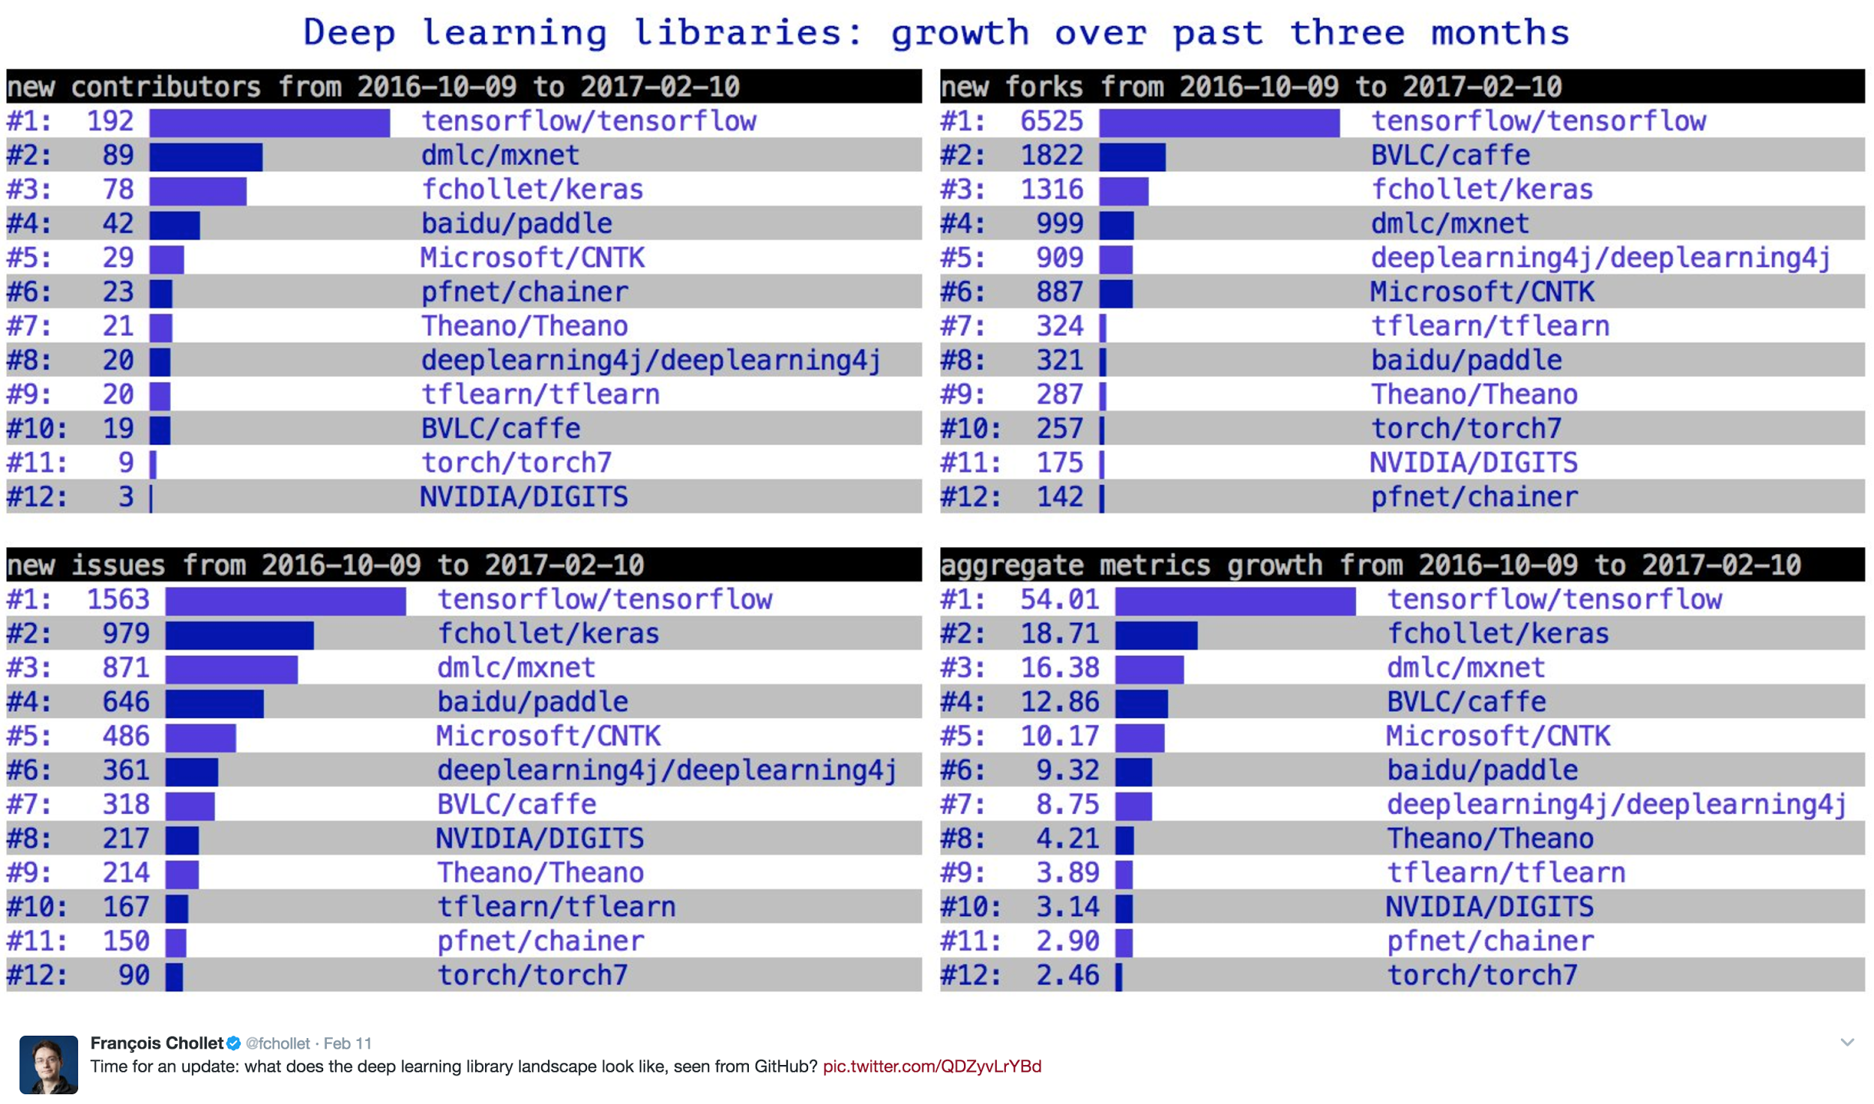
https://twitter.com/fchollet/status/830499993450450944/

Slide 33
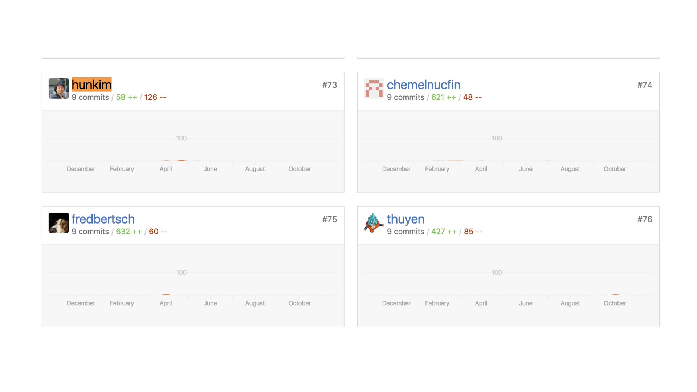

Slide 34

TensorFlow
TensorFlow™ is an open source software library for numerical computation using data flow graphs.
Python!
https://www.tensorflow.org/

Slide 35
What is a Data Flow Graph?
Nodes in the graph represent mathematical operations
Edges represent the multidimensional data arrays (tensors) communicated between them.
https://www.tensorflow.org/
Notes:
Nirmal Jith: “why tensorflow uses a graph based approach? For example, it will help to split to sub graphs and hence parallel processing will be easier. If you can include that it will be great.”

Slide 36
Installing TensorFlow
Linux, Mac OSX, Windows
(sudo -H) pip install --upgrade tensorflow
(sudo -H) pip install --upgrade tensorflow-gpu
From source
bazel ...
https://www.tensorflow.org/install/install_sources
Google search/Community help
https://www.tensorflow.org/install/

Slide 37
Check installation and version
Sungs-MacBook-Pro:hunkim$ python3
Python 3.6.0 (v3.6.0:41df79263a11, Dec 22 2016, 17:23:13)
[GCC 4.2.1 (Apple Inc. build 5666) (dot 3)] on darwin
Type "help", "copyright", "credits" or "license" for more information.
>>> import tensorflow as tf
>>> tf.__version__
'1.0.0'
>>>

Slide 38
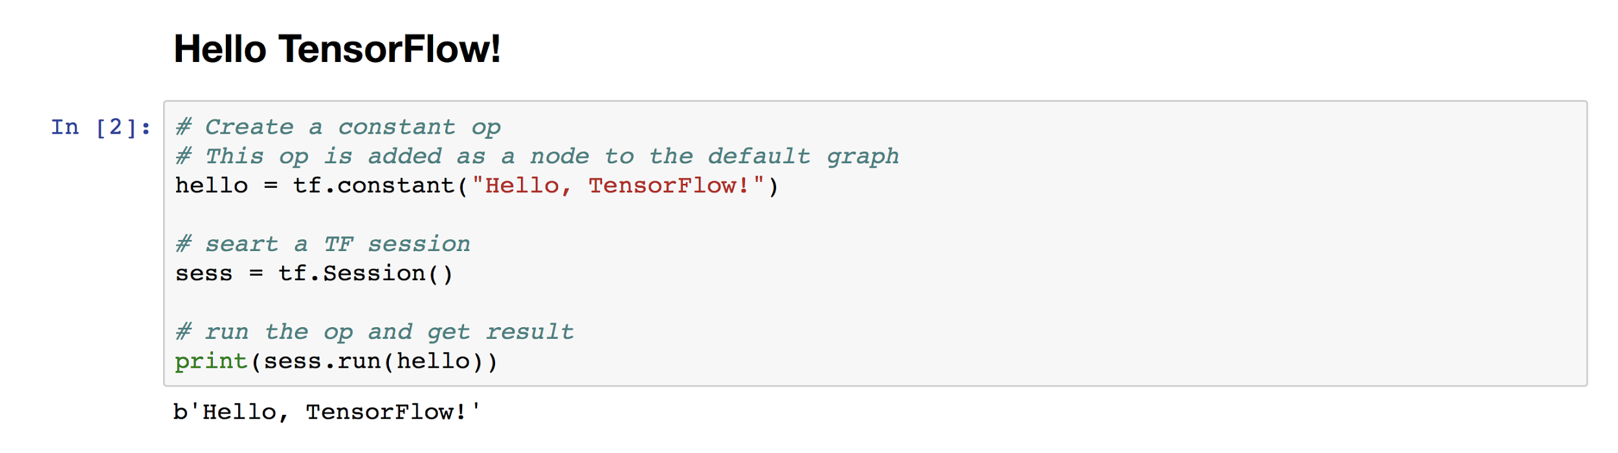
TensorFlow Hello World!
b’String’ ‘b’ indicates Bytes literals. http://stackoverflow.com/questions/6269765/
https://github.com/hunkim/DeepLearningZeroToAll/blob/master/lab-01-basics.ipynb

Slide 39
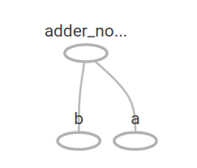
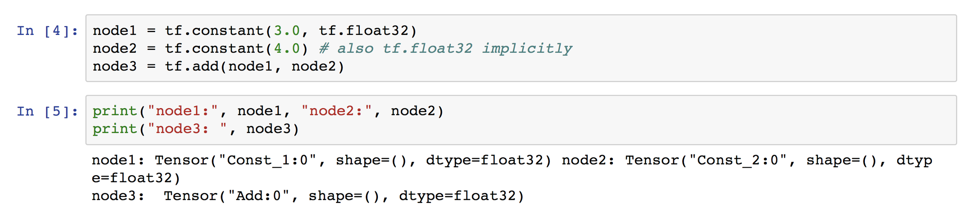
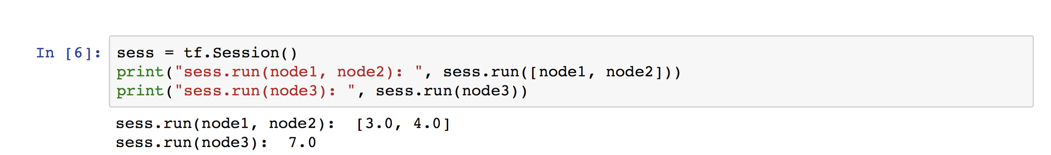
Computational Graph
https://github.com/hunkim/DeepLearningZeroToAll/blob/master/lab-01-basics.ipynb

Slide 40

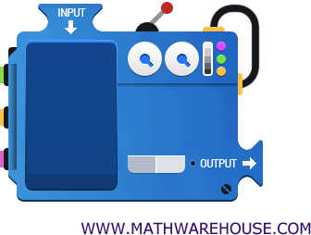
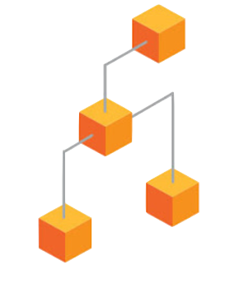



TensorFlow Mechanics
feed data and run graph (operation) sess.run (op)
Build graph using
TensorFlow operations
update variables
in the graph
(and return values)

Slide 41

Computational Graph
Build graph (tensors) using TensorFlow operations
(2) feed data and run graph (operation) sess.run (op)
(3) update variables in the graph
(and return values)
https://github.com/hunkim/DeepLearningZeroToAll/blob/master/lab-01-basics.ipynb
Notes:
TODO: Kabjin Kwon 13 페이지 그림과 동일한 이유로 코드와 일치하는 그림으로 수정 필요

Slide 42
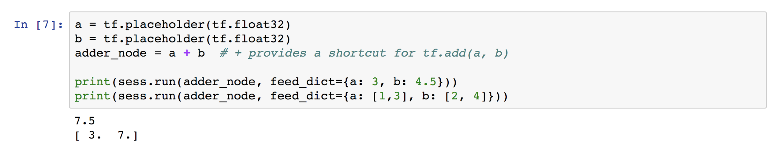
Placeholder
https://github.com/hunkim/DeepLearningZeroToAll/blob/master/lab-01-basics.ipynb
Notes:
Jin Sam Kim “플레이스홀더는 레이지 기법으로 값을 미리 정하지 않고, 프로그래밍이 돌아가는 시점에 정해지는 값입니다. 변수의 형태(type)만 정해 놓고, 변수의 값은 정해지지 않았지만 텐서플로우가 실행되는 동안에 정해집니다. 값이 미리 정해지지 않고, 나중에 정해지는 점은 굉장히 유연한 프로그래밍을 할 수 있게
도와줍니다.”
“feed_dict={값}
이 문법은 run function에서 argument로 받는 특정 이름을 지칭하는 것입니다.
자바 같은 경우에는 argument 순서에 의해서 전달되는 파라미터가 어떤 argument에 매칭될지가 정해지는데, 파이썬에서는 argument이름을 정해줌으로써 순서에 상관 없이 파라미터를 전달 할 수 있는 장점이 있습니다.
텐서플로우 1.0 기준으로 Session.run 에는 4개의 arguments가 있는데, 그 중 하나인 feed_dict를 특정해서 파라미터를 전달할 수 있습니다.”

Slide 43
TensorFlow Mechanics
feed data and run graph (operation) sess.run (op, feed_dict={x: x_data})
Build graph using
TensorFlow operations
update variables
in the graph
(and return values)

Slide 44
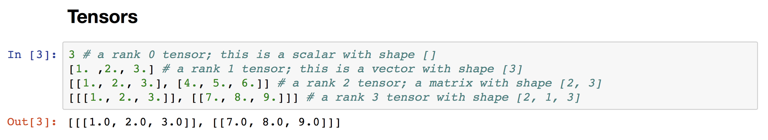
Everything is Tensor
t = tf.Constant([1., 2., 3.])
Notes:
“Kabjin Kwon 텐서 예제로 코드로 나온 것은 파이썬 리스트로 표현한 텐서라고 설명하면 적절한 설명일 것 같습니다. 텐서 플로우의 Tensor 클래스로 예제를 만들어 보여 주면 어떨까요? 수학적인 텐서를 설명하고자 한다면, 다른 좋은 자료의 그림을 빌려서 넣으면 어떨까 싶습니다. 뒷 페이지에는 t에 파이썬 리스트로 되어 있는데 데이터를 넣어서 텐서에 값을 채우는 예제가 나오는데 t에 대한 정의가 없습니다. 연속성을 위해서 tf.Tensor 클래스 타입의 t를 만드는 것을 보여 주는 것이 좋을 것 같습니다. 즉 아래와 같이요.”
t = tf.Constant([1., 2., 3.])

Slide 45

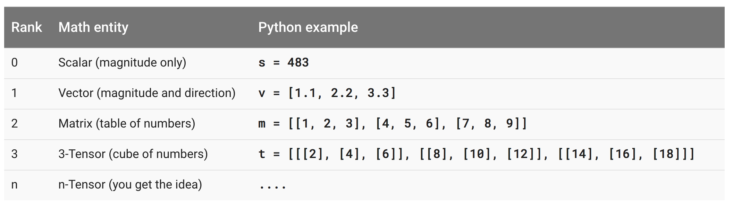
Tensor Ranks, Shapes, and Types
https://www.tensorflow.org/programmers_guide/dims_types

Slide 46
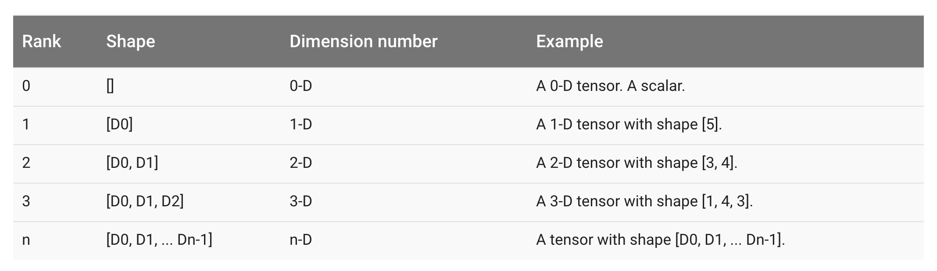
Tensor Ranks, Shapes, and Types
https://www.tensorflow.org/programmers_guide/dims_types

Slide 47
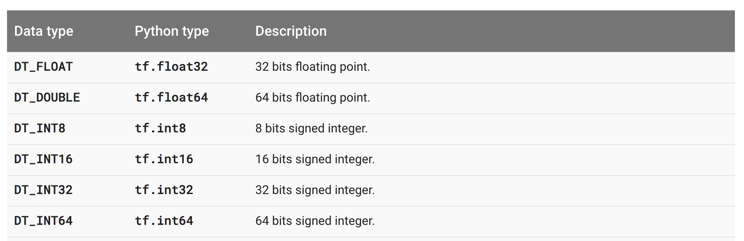
Tensor Ranks, Shapes, and Types
...
https://www.quora.com/When-should-I-use-tf-float32-vs-tf-float64-in-TensorFlow
Notes:
https://www.quora.com/When-should-I-use-tf-float32-vs-tf-float64-in-TensorFlow
https://www.quora.com/When-should-I-use-tf-float32-vs-tf-float64-in-TensorFlow
아 여기에 설명이 잘 되어있네요
큰 정확도의 차이는 없지만
딥러닝을 할때, 많은 용량의 데이터를 사용하고 GPU메모리상 문제도 있어서 tf.float32를 주로 쓴다네요!1
속도면이나 메모리면에서 더 좋다고 ..
물론 정확도는 tf.float64가 더 좋지만 큰 차이는 없다하네요

Slide 48
TensorFlow Mechanics
feed data and run graph (operation) sess.run (op, feed_dict={x: x_data})
Build graph using
TensorFlow operations
update variables
in the graph
(and return values)

Slide 49
Machine Learning Basics
Linear Regression
Logistic Regression (Binary classification)
Softmax Classification
Neural Networks

Slide 50
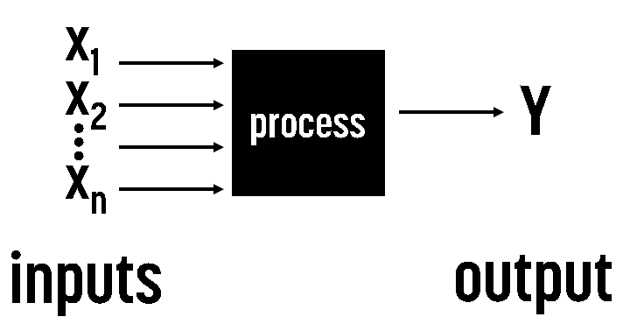

Regression

Slide 51
Predicting exam score: regression
x (hours) | y (score)
10 | 90
9 | 80
3 | 50
2 | 30

Slide 52
Regression (data)
x | y
1 | 1
2 | 2
3 | 3

Slide 53
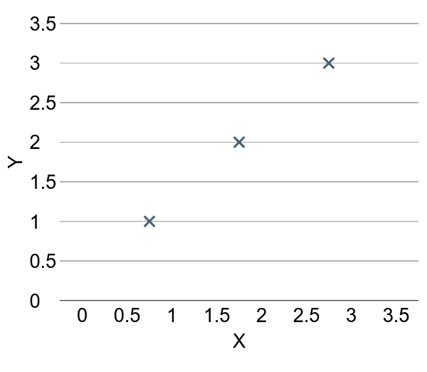
Regression (presentation)
x | Y
1 | 1
2 | 2
3 | 3

Slide 54



(Linear) Hypothesis
X = 2.5
Y = ?

Slide 55
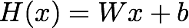
(Linear) Hypothesis

Slide 56
Which hypothesis is better?

Slide 57

Which hypothesis is better?

Slide 58
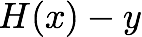
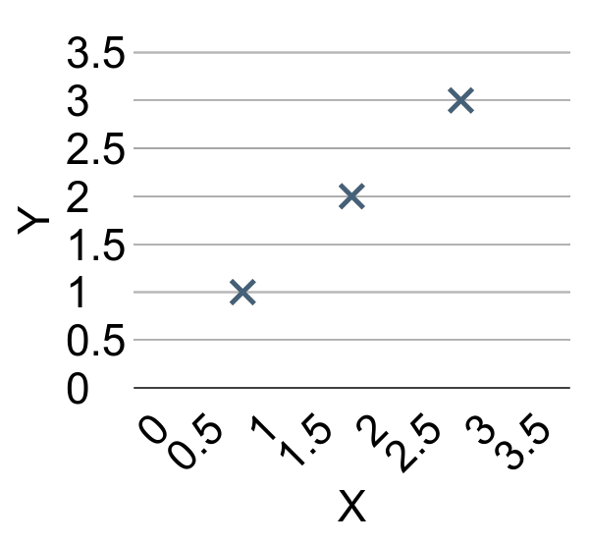

Cost function
How fit the line to our (training) data

Slide 59

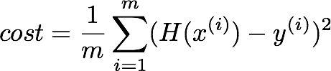
Cost function
How fit the line to our (training) data

Slide 60
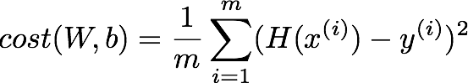
Cost function

Slide 61
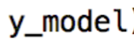
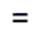
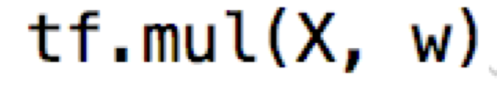
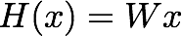
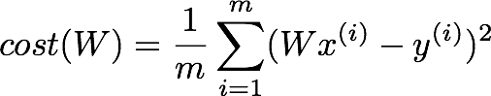

Simplified hypothesis in TF

Slide 62
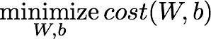
Goal: Minimize cost

Slide 63
What cost(W) looks like?
x | Y
1 | 1
2 | 2
3 | 3
W=1, cost(W)=?

Slide 64
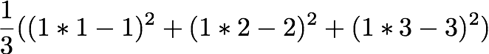
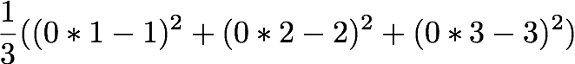
What cost(W) looks like?
x | Y
1 | 1
2 | 2
3 | 3
W=1, cost(W)=0
W=0, cost(W)=4.67
W=2, cost(W)=?

Slide 65
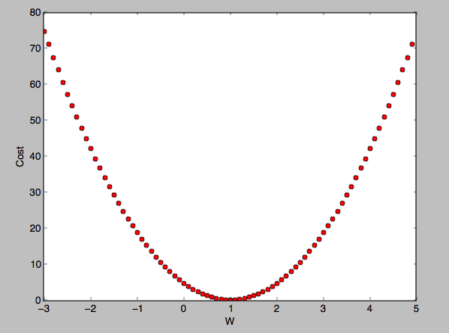
What cost(W) looks like?
W=1, cost(W)=0
W=0, cost(W)=4.67
W=2, cost(W)=4.67

Slide 66
How to minimize cost?

Slide 67
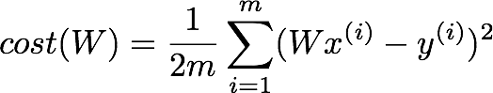
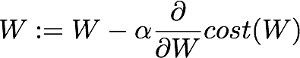
Formal definition

Slide 68
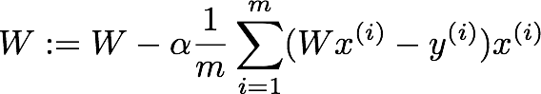

Gradient descent algorithm in TF

Slide 69
TensorFlow Mechanics
feed data and run graph (operation) sess.run (op, feed_dict={x: x_data})
Build graph using
TensorFlow operations
update variables
in the graph
(and return values)

Slide 70
Build graph using TF operations
# X and Y data
x_train = [1, 2, 3]
y_train = [1, 2, 3]
W = tf.Variable(tf.random_normal([1]), name='weight')
b = tf.Variable(tf.random_normal([1]), name='bias')
# Our hypothesis XW+b
hypothesis = x_train * W + b
# cost/loss function
cost = tf.reduce_mean(tf.square(hypothesis - y_train))

Slide 71
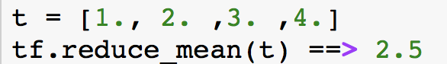
Build graph using TF operations
# cost/loss function
cost = tf.reduce_mean(tf.square(hypothesis - y_train))
GradientDescent
# Minimize
optimizer = tf.train.GradientDescentOptimizer(learning_rate=0.01)
train = optimizer.minimize(cost)
https://www.tensorflow.org/api_docs/python/tf/reduce_mean

Slide 72
Run/update graph and get results
# Launch the graph in a session.
sess = tf.Session()
# Initializes global variables in the graph.
sess.run(tf.global_variables_initializer())
# Fit the line
for step in range(2001):
sess.run(train)
if step % 20 == 0:
print(step, sess.run(cost), sess.run(W), sess.run(b))

Slide 73
import tensorflow as tf
# X and Y data
x_train = [1, 2, 3]
y_train = [1, 2, 3]
W = tf.Variable(tf.random_normal([1]), name='weight')
b = tf.Variable(tf.random_normal([1]), name='bias')
# Our hypothesis XW+b
hypothesis = x_train * W + b
# cost/loss function
cost = tf.reduce_mean(tf.square(hypothesis - y_train))
# Minimize
optimizer = tf.train.GradientDescentOptimizer(learning_rate=0.01)
train = optimizer.minimize(cost)
# Launch the graph in a session.
sess = tf.Session()
# Initializes global variables in the graph.
sess.run(tf.global_variables_initializer())
# Fit the line
for step in range(2001):
sess.run(train)
if step % 20 == 0:
print(step, sess.run(cost), sess.run(W), sess.run(b))
Full code (less than 20 lines)
'''
0 2.82329 [ 2.12867713] [-0.85235667]
20 0.190351 [ 1.53392804] [-1.05059612]
40 0.151357 [ 1.45725465] [-1.02391243]
...
1920 1.77484e-05 [ 1.00489295] [-0.01112291]
1940 1.61197e-05 [ 1.00466311] [-0.01060018]
1960 1.46397e-05 [ 1.004444] [-0.01010205]
1980 1.32962e-05 [ 1.00423515] [-0.00962736]
2000 1.20761e-05 [ 1.00403607] [-0.00917497]
'''

Slide 74
Placeholders
https://github.com/hunkim/DeepLearningZeroToAll/blob/master/lab-01-basics.ipynb

Slide 75
Placeholders
# X and Y data
x_train = [1, 2, 3]
y_train = [1, 2, 3]
# Now we can use X and Y in place of x_data and y_data
# # placeholders for a tensor that will be always fed using feed_dict
# See http://stackoverflow.com/questions/36693740/
X = tf.placeholder(tf.float32)
Y = tf.placeholder(tf.float32)
...
# Fit the line
for step in range(2001):
cost_val, W_val, b_val, _ = \
sess.run([cost, W, b, train],
feed_dict={X: [1, 2, 3], Y: [1, 2, 3]})
if step % 20 == 0:
print(step, cost_val, W_val, b_val)

Slide 76
import tensorflow as tf
W = tf.Variable(tf.random_normal([1]), name='weight')
b = tf.Variable(tf.random_normal([1]), name='bias')
X = tf.placeholder(tf.float32, shape=[None])
Y = tf.placeholder(tf.float32, shape=[None])
# Our hypothesis XW+b
hypothesis = X * W + b
# cost/loss function
cost = tf.reduce_mean(tf.square(hypothesis - Y))
# Minimize
optimizer = tf.train.GradientDescentOptimizer(learning_rate=0.01)
train = optimizer.minimize(cost)
# Launch the graph in a session.
sess = tf.Session()
# Initializes global variables in the graph.
sess.run(tf.global_variables_initializer())
# Fit the line
for step in range(2001):
cost_val, W_val, b_val, _ = sess.run([cost, W, b, train],
feed_dict={X: [1, 2, 3], Y: [1, 2, 3]})
if step % 20 == 0:
print(step, cost_val, W_val, b_val)
Full code with placeholders
...
1980 1.32962e-05 [ 1.00423515] [-0.00962736]
2000 1.20761e-05 [ 1.00403607] [-0.00917497]
# Testing our model
print(sess.run(hypothesis, feed_dict={X: [5]}))
print(sess.run(hypothesis, feed_dict={X: [2.5]}))
print(sess.run(hypothesis,
feed_dict={X: [1.5, 3.5]}))
[ 5.0110054]
[ 2.50091505]
[ 1.49687922 3.50495124]

Slide 77
import tensorflow as tf
W = tf.Variable(tf.random_normal([1]), name='weight')
b = tf.Variable(tf.random_normal([1]), name='bias')
X = tf.placeholder(tf.float32, shape=[None])
Y = tf.placeholder(tf.float32, shape=[None])
# Our hypothesis XW+b
hypothesis = X * W + b
# cost/loss function
cost = tf.reduce_mean(tf.square(hypothesis - Y))
# Minimize
optimizer = tf.train.GradientDescentOptimizer(learning_rate=0.01)
train = optimizer.minimize(cost)
# Launch the graph in a session.
sess = tf.Session()
# Initializes global variables in the graph.
sess.run(tf.global_variables_initializer())
# Fit the line with new training data
for step in range(2001):
cost_val, W_val, b_val, _ = sess.run([cost, W, b, train],
feed_dict={X: [1, 2, 3, 4, 5],
Y: [2.1, 3.1, 4.1, 5.1, 6.1]})
if step % 20 == 0:
print(step, cost_val, W_val, b_val)
Full code with placeholders
…
1960 3.32396e-07 [ 1.00037301] [ 1.09865296]
1980 2.90429e-07 [ 1.00034881] [ 1.09874094]
2000 2.5373e-07 [ 1.00032604] [ 1.09882331]
# Testing our model
print(sess.run(hypothesis, feed_dict={X: [5]}))
print(sess.run(hypothesis, feed_dict={X: [2.5]}))
print(sess.run(hypothesis,
feed_dict={X: [1.5, 3.5]}))
[ 6.10045338]
[ 3.59963846]
[ 2.59931231 4.59996414]

Slide 78
TensorFlow Mechanics
feed_dict={X: [1, 2, 3, 4, 5],
Y: [2.1, 3.1, 4.1, 5.1, 6.1]})
feed data and run graph (operation) sess.run (op, feed_dict={x: x_data})
Build graph using
TensorFlow operations
update variables
in the graph
(and return values)
…
train = optimizer.minimize(cost)

Slide 79
Machine Learning Basics
Linear Regression
Logistic Regression (Binary classification)
Softmax Classification
Neural Networks

Slide 80

Classification

Slide 81
Linear Regression Hypothesis

Slide 82
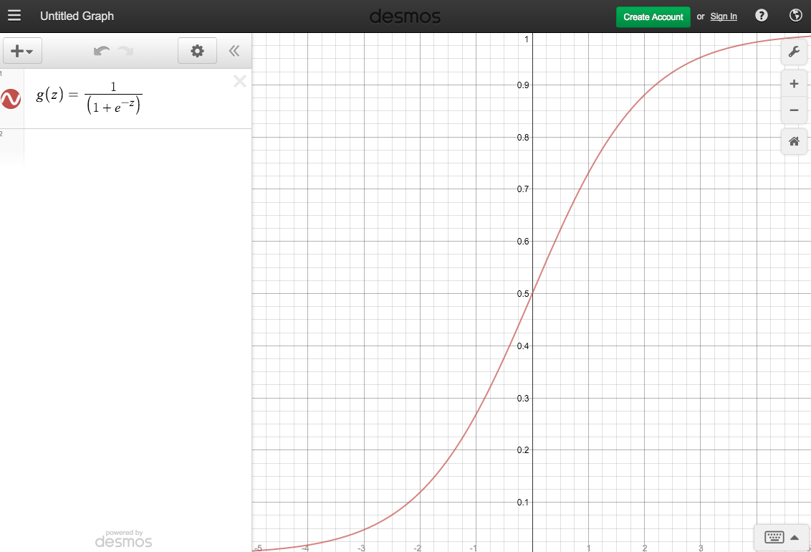
logistic function,
sigmoid function.
sigmoid:
Curved in two directions,
like the letter "S",
or the Greek ς (sigma).

Slide 83
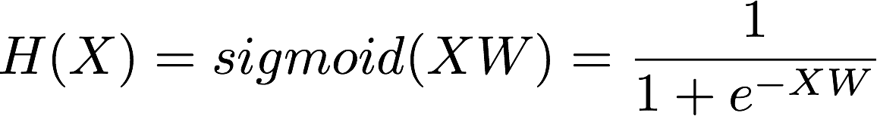

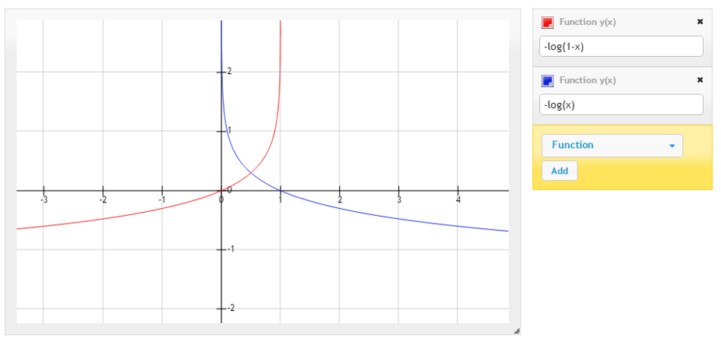
Logistic Regression
Case for y=1
Case for y=0
Notes:
H(X) = \frac{1}{1 + e^{-W^{T}X}} \\
H(X) = sigmoid(XW) = \frac{1}{1 + e^{-XW}} \\
cost(W)=-\frac{1}{m}\sum {\color{blue}y} log(H(x)) + {\color{blue}(1-y)}(log(1-H(x)) \\
W = W - \alpha\frac{\partial}{\partial W}cost(W)

Slide 84
Logistic Classification in TF
hypothesis = tf.sigmoid(tf.matmul(X, W) + b)
# cost/loss function
cost = -tf.reduce_mean(Y * tf.log(hypothesis) + (1 - Y) *
tf.log(1 - hypothesis))

Slide 85
Training Data
x_data = [[1, 2], [2, 3], [3, 1], [4, 3], [5, 3], [6, 2]]
y_data = [[0], [0], [0], [1], [1], [1]]
# placeholders for a tensor that will be always fed.
X = tf.placeholder(tf.float32, shape=[None, 2])
Y = tf.placeholder(tf.float32, shape=[None, 1])
https://github.com/hunkim/DeepLearningZeroToAll/blob/master/lab-05-1-logistic_regression.py

Slide 86
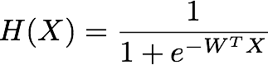
X = tf.placeholder(tf.float32, shape=[None, 2])
Y = tf.placeholder(tf.float32, shape=[None, 1])
W = tf.Variable(tf.random_normal([2, 1]), name='weight')
b = tf.Variable(tf.random_normal([1]), name='bias')
# Hypothesis using sigmoid: tf.div(1., 1. + tf.exp(tf.matmul(X, W) + b))
hypothesis = tf.sigmoid(tf.matmul(X, W) + b)
# cost/loss function
cost = -tf.reduce_mean(Y * tf.log(hypothesis) + (1 - Y) *
tf.log(1 - hypothesis))
train = tf.train.GradientDescentOptimizer(learning_rate=0.01).minimize(cost)
# Accuracy computation
# True if hypothesis>0.5 else False
predicted = tf.cast(hypothesis > 0.5, dtype=tf.float32)
accuracy = tf.reduce_mean(tf.cast(tf.equal(predicted, Y), dtype=tf.float32))
https://github.com/hunkim/DeepLearningZeroToAll/blob/master/lab-05-1-logistic_regression.py

Slide 87
Train the model
# Launch graph
with tf.Session() as sess:
# Initialize TensorFlow variables
sess.run(tf.global_variables_initializer())
for step in range(10001):
cost_val, _ = sess.run([cost, train], feed_dict={X: x_data, Y: y_data})
if step % 200 == 0:
print(step, cost_val)
# Accuracy report
h, c, a = sess.run([hypothesis, predicted, accuracy],
feed_dict={X: x_data, Y: y_data})
print("\nHypothesis: ", h, "\nCorrect (Y): ", c, "\nAccuracy: ", a)
https://github.com/hunkim/DeepLearningZeroToAll/blob/master/lab-05-1-logistic_regression.py

Slide 88
x_data = [[1, 2], [2, 3], [3, 1], [4, 3], [5, 3], [6, 2]]
y_data = [[0], [0], [0], [1], [1], [1]]
# placeholders for a tensor that will be always fed.
X = tf.placeholder(tf.float32, shape=[None, 2])
Y = tf.placeholder(tf.float32, shape=[None, 1])
W = tf.Variable(tf.random_normal([2, 1]), name='weight')
b = tf.Variable(tf.random_normal([1]), name='bias')
# Hypothesis using sigmoid: tf.div(1., 1. + tf.exp(tf.matmul(X, W)))
hypothesis = tf.sigmoid(tf.matmul(X, W) + b)
# cost/loss function
cost = -tf.reduce_mean(Y * tf.log(hypothesis) + (1 - Y) * tf.log(1 - hypothesis))
train = tf.train.GradientDescentOptimizer(learning_rate=0.01).minimize(cost)
# Accuracy computation
# True if hypothesis>0.5 else False
predicted = tf.cast(hypothesis > 0.5, dtype=tf.float32)
accuracy = tf.reduce_mean(tf.cast(tf.equal(predicted, Y), dtype=tf.float32))
# Launch graph
with tf.Session() as sess:
# Initialize TensorFlow variables
sess.run(tf.global_variables_initializer())
for step in range(10001):
cost_val, _ = sess.run([cost, train], feed_dict={X: x_data, Y: y_data})
if step % 200 == 0:
print(step, cost_val)
# Accuracy report
h, c, a = sess.run([hypothesis, predicted, accuracy],
feed_dict={X: x_data, Y: y_data})
print("\nHypothesis: ", h, "\nCorrect (Y): ", c, "\nAccuracy: ", a)
# step, cost
0 1.73078
200 0.571512
400 0.507414
...
9600 0.154132
9800 0.151778
10000 0.149496
Hypothesis:
[[ 0.03074029]
[ 0.15884677]
[ 0.30486736]
[ 0.78138196]
[ 0.93957496]
[ 0.98016882]]
Correct (Y):
[[ 0.]
[ 0.]
[ 0.]
[ 1.]
[ 1.]
[ 1.]]
Accuracy: 1.0
https://github.com/hunkim/DeepLearningZeroToAll/blob/master/lab-05-1-logistic_regression.py

Slide 89


Classifying diabetes
xy = np.loadtxt('data-03-diabetes.csv', delimiter=',', dtype=np.float32)
x_data = xy[:, 0:-1]
y_data = xy[:, [-1]]
https://github.com/hunkim/DeepLearningZeroToAll/blob/master/lab-05-2-logistic_regression_diabetes.py

Slide 90
xy = np.loadtxt('data-03-diabetes.csv', delimiter=',', dtype=np.float32)
x_data = xy[:, 0:-1]
y_data = xy[:, [-1]]
# placeholders for a tensor that will be always fed.
X = tf.placeholder(tf.float32, shape=[None, 8])
Y = tf.placeholder(tf.float32, shape=[None, 1])
W = tf.Variable(tf.random_normal([8, 1]), name='weight')
b = tf.Variable(tf.random_normal([1]), name='bias')
# Hypothesis using sigmoid: tf.div(1., 1. + tf.exp(tf.matmul(X, W)))
hypothesis = tf.sigmoid(tf.matmul(X, W) + b)
# cost/loss function
cost = -tf.reduce_mean(Y * tf.log(hypothesis) + (1 - Y) * tf.log(1 - hypothesis))
train = tf.train.GradientDescentOptimizer(learning_rate=0.01).minimize(cost)
# Accuracy computation
# True if hypothesis>0.5 else False
predicted = tf.cast(hypothesis > 0.5, dtype=tf.float32)
accuracy = tf.reduce_mean(tf.cast(tf.equal(predicted, Y), dtype=tf.float32))
# Launch graph
with tf.Session() as sess:
sess.run(tf.global_variables_initializer())
feed = {X: x_data, Y: y_data}
for step in range(10001):
sess.run(train, feed_dict=feed)
if step % 200 == 0:
print(step, sess.run(cost, feed_dict=feed))
# Accuracy report
h, c, a = sess.run([hypothesis, predicted, accuracy], feed_dict=feed)
print("\nHypothesis: ", h, "\nCorrect (Y): ", c, "\nAccuracy: ", a)
0 0.82794
200 0.755181
400 0.726355
600 0.705179
800 0.686631
...
9600 0.492056
9800 0.491396
10000 0.490767
[ 0.7461012 ]
[ 0.79919308]
[ 0.72995949]
[ 0.88297188]]
[ 1.]
[ 1.]
[ 1.]]
Accuracy: 0.762846
https://github.com/hunkim/DeepLearningZeroToAll/blob/master/lab-05-2-logistic_regression_diabetes.py

Slide 91
Machine Learning Basics
Linear Regression
Logistic Regression (Binary classification)
Softmax Classification
Neural Networks

Slide 92

Multiple labels (a, b, c)

Slide 93

Softmax function
https://www.udacity.com/course/viewer#!/c-ud730/l-6370362152/m-6379811817
Notes:
P(y=i|x) = S(y_{i}) = \frac{e^{y_{i}}}{\sum_{j}e^{y_{j}}} \in (0,1)

Slide 94
hypothesis = tf.nn.softmax(tf.matmul(X,W)+b)
tf.matmul(X,W)+b
https://www.udacity.com/course/viewer#!/c-ud730/l-6370362152/m-6379811817

Slide 95


Cost function: cross entropy
# Cross entropy cost/loss
cost = tf.reduce_mean(-tf.reduce_sum(Y * tf.log(hypothesis), axis=1))
optimizer = tf.train.GradientDescentOptimizer(learning_rate=0.1).minimize(cost)
https://www.udacity.com/course/viewer#!/c-ud730/l-6370362152/m-6379811817

Slide 96
Cost function: cross entropy
hypothesis = tf.nn.softmax(tf.matmul(X,W)+b)
# Cross entropy cost/loss
cost = tf.reduce_mean
(-tf.reduce_sum(Y * tf.log(hypothesis), axis=1))
optimizer = tf.train.GradientDescentOptimizer(learning_rate=0.1).
minimize(cost)
https://www.udacity.com/course/viewer#!/c-ud730/l-6370362152/m-6379811817

Slide 97

x_data = [[1, 2, 1, 1], [2, 1, 3, 2], [3, 1, 3, 4], [4, 1, 5, 5], [1, 7, 5, 5],
[1, 2, 5, 6], [1, 6, 6, 6], [1, 7, 7, 7]]
y_data = [[0, 0, 1], [0, 0, 1], [0, 0, 1], [0, 1, 0], [0, 1, 0], [0, 1, 0], [1, 0, 0], [1, 0, 0]]
X = tf.placeholder("float", [None, 4])
Y = tf.placeholder("float", [None, 3])
nb_classes = 3
W = tf.Variable(tf.random_normal([4, nb_classes]), name='weight')
b = tf.Variable(tf.random_normal([nb_classes]), name='bias')
# tf.nn.softmax computes softmax activations
# softmax = exp(logits) / reduce_sum(exp(logits), dim)
hypothesis = tf.nn.softmax(tf.matmul(X, W) + b)
# Cross entropy cost/loss
cost = tf.reduce_mean(-tf.reduce_sum(Y * tf.log(hypothesis), axis=1))
optimizer = tf.train.GradientDescentOptimizer(learning_rate=0.1).minimize(cost)
# Launch graph
with tf.Session() as sess:
sess.run(tf.global_variables_initializer())
for step in range(2001):
sess.run(optimizer, feed_dict={X: x_data, Y: y_data})
if step % 200 == 0:
print(step, sess.run(cost, feed_dict={X: x_data, Y: y_data}))
https://github.com/hunkim/DeepLearningZeroToAll/blob/master/lab-06-1-softmax_classifier.py

Slide 98

Test & one-hot encoding
hypothesis = tf.nn.softmax(tf.matmul(X,W)+b)
# Testing & One-hot encoding
a = sess.run(hypothesis, feed_dict={X: [[1, 11, 7, 9]]})
print(a, sess.run(tf.arg_max(a, 1)))
[[ 1.38904958e-03 9.98601854e-01 9.06129117e-06]] [1]
https://github.com/hunkim/DeepLearningZeroToAll/blob/master/lab-06-1-softmax_classifier.py

Slide 99
Test & one-hot encoding
hypothesis = tf.nn.softmax(tf.matmul(X,W)+b)
all = sess.run(hypothesis, feed_dict={X: [[1, 11, 7, 9],
[1, 3, 4, 3],
[1, 1, 0, 1]]})
print(all, sess.run(tf.arg_max(all, 1)))
[[ 1.38904958e-03 9.98601854e-01 9.06129117e-06]
[ 9.31192040e-01 6.29020557e-02 5.90589503e-03]
[ 1.27327668e-08 3.34112905e-04 9.99665856e-01]]
[1 0 2]
https://github.com/hunkim/DeepLearningZeroToAll/blob/master/lab-06-1-softmax_classifier.py

Slide 100


MNIST Dataset
http://yann.lecun.com/exdb/mnist/

Slide 101

28x28x1 image
# MNIST data image of shape 28 * 28 = 784
X = tf.placeholder(tf.float32, [None, 784])
# 0 - 9 digits recognition = 10 classes
Y = tf.placeholder(tf.float32, [None, nb_classes])
http://derindelimavi.blogspot.hk/2015/04/mnist-el-yazs-rakam-veri-seti.html

Slide 102
MNIST Dataset
from tensorflow.examples.tutorials.mnist import input_data
# Check out https://www.tensorflow.org/get_started/mnist/beginners for
# more information about the mnist dataset
mnist = input_data.read_data_sets("MNIST_data/", one_hot=True)
…
batch_xs, batch_ys = mnist.train.next_batch(100)
…
print("Accuracy: ", accuracy.eval(session=sess,
feed_dict={X: mnist.test.images, Y: mnist.test.labels}))
https://github.com/hunkim/DeepLearningZeroToAll/blob/master/lab-07-4-mnist_introduction.py

Slide 103
Reading data and set variables
from tensorflow.examples.tutorials.mnist import input_data
# Check out https://www.tensorflow.org/get_started/mnist/beginners for
# more information about the mnist dataset
mnist = input_data.read_data_sets("MNIST_data/", one_hot=True)
nb_classes = 10
# MNIST data image of shape 28 * 28 = 784
X = tf.placeholder(tf.float32, [None, 784])
# 0 - 9 digits recognition = 10 classes
Y = tf.placeholder(tf.float32, [None, nb_classes])
W = tf.Variable(tf.random_normal([784, nb_classes]))
b = tf.Variable(tf.random_normal([nb_classes]))
https://github.com/hunkim/DeepLearningZeroToAll/blob/master/lab-07-4-mnist_introduction.py

Slide 104
Softmax!
# Hypothesis (using softmax)
hypothesis = tf.nn.softmax(tf.matmul(X, W) + b)
cost = tf.reduce_mean(-tf.reduce_sum(Y * tf.log(hypothesis), axis=1))
optimizer = tf.train.GradientDescentOptimizer(learning_rate=0.1).minimize(cost)
# Test model
is_correct = tf.equal(tf.arg_max(hypothesis, 1), tf.arg_max(Y, 1))
# Calculate accuracy
accuracy = tf.reduce_mean(tf.cast(is_correct, tf.float32))
https://github.com/hunkim/DeepLearningZeroToAll/blob/master/lab-07-4-mnist_introduction.py

Slide 105
Training epoch/batch
# parameters
training_epochs = 15
batch_size = 100
with tf.Session() as sess:
# Initialize TensorFlow variables
sess.run(tf.global_variables_initializer())
# Training cycle
for epoch in range(training_epochs):
avg_cost = 0
total_batch = int(mnist.train.num_examples / batch_size)
for i in range(total_batch):
batch_xs, batch_ys = mnist.train.next_batch(batch_size)
c, _ = sess.run([cost, optimizer], feed_dict={X: batch_xs, Y: batch_ys})
avg_cost += c / total_batch
print('Epoch:', '%04d' % (epoch + 1), 'cost =', '{:.9f}'.format(avg_cost))
https://github.com/hunkim/DeepLearningZeroToAll/blob/master/lab-07-4-mnist_introduction.py

Slide 106
Training epoch/batch
In the neural network terminology:
one epoch = one forward pass and one backward pass of all the training examples
batch size = the number of training examples in one forward/backward pass. The higher the batch size, the more memory space you'll need.
number of iterations = number of passes, each pass using [batch size] number of examples. To be clear, one pass = one forward pass + one backward pass (we do not count the forward pass and backward pass as two different passes).
Example: if you have 1000 training examples, and your batch size is 500, then it will take 2 iterations to complete 1 epoch.
http://stackoverflow.com/questions/4752626/epoch-vs-iteration-when-training-neural-networks

Slide 107
Training epoch/batch
# parameters
training_epochs = 15
batch_size = 100
with tf.Session() as sess:
# Initialize TensorFlow variables
sess.run(tf.global_variables_initializer())
# Training cycle
for epoch in range(training_epochs):
avg_cost = 0
total_batch = int(mnist.train.num_examples / batch_size)
for i in range(total_batch):
batch_xs, batch_ys = mnist.train.next_batch(batch_size)
c, _ = sess.run([cost, optimizer], feed_dict={X: batch_xs, Y: batch_ys})
avg_cost += c / total_batch
print('Epoch:', '%04d' % (epoch + 1), 'cost =', '{:.9f}'.format(avg_cost))
https://github.com/hunkim/DeepLearningZeroToAll/blob/master/lab-07-4-mnist_introduction.py

Slide 108
Report results on test dataset
# Test the model using test sets
print("Accuracy: ", accuracy.eval(session=sess,
feed_dict={X: mnist.test.images, Y: mnist.test.labels}))
https://github.com/hunkim/DeepLearningZeroToAll/blob/master/lab-07-4-mnist_introduction.py

Slide 109
hypothesis = tf.nn.softmax(tf.matmul(X, W) + b)
cost = tf.reduce_mean(-tf.reduce_sum(Y * tf.log(hypothesis), axis=1))
optimizer = tf.train.GradientDescentOptimizer(learning_rate=0.1).minimize(cost)
is_correct = tf.equal(tf.arg_max(hypothesis, 1), tf.arg_max(Y, 1))
accuracy = tf.reduce_mean(tf.cast(is_correct, tf.float32))
# parameters
training_epochs = 15
batch_size = 100
with tf.Session() as sess:
# Initialize TensorFlow variables
sess.run(tf.global_variables_initializer())
# Training cycle
for epoch in range(training_epochs):
avg_cost = 0
total_batch = int(mnist.train.num_examples / batch_size)
for i in range(total_batch):
batch_xs, batch_ys = mnist.train.next_batch(batch_size)
c, _ = sess.run([cost, optimizer],
feed_dict={X: batch_xs, Y: batch_ys})
avg_cost += c / total_batch
print('Epoch:', '%04d' % (epoch + 1),
'cost =', '{:.9f}'.format(avg_cost))
Epoch: 0001 cost = 2.868104637
Epoch: 0002 cost = 1.134684615
Epoch: 0003 cost = 0.908220728
Epoch: 0004 cost = 0.794199896
Epoch: 0005 cost = 0.721815854
Epoch: 0006 cost = 0.670184430
Epoch: 0007 cost = 0.630576546
Epoch: 0008 cost = 0.598888191
Epoch: 0009 cost = 0.573027079
Epoch: 0010 cost = 0.550497213
Epoch: 0011 cost = 0.532001859
Epoch: 0012 cost = 0.515517795
Epoch: 0013 cost = 0.501175288
Epoch: 0014 cost = 0.488425370
Epoch: 0015 cost = 0.476968593
Learning finished
Accuracy: 0.888
https://github.com/hunkim/DeepLearningZeroToAll/blob/master/lab-07-4-mnist_introduction.py

Slide 110

Sample image show and prediction
import matplotlib.pyplot as plt
import random
# Get one and predict
r = random.randint(0, mnist.test.num_examples - 1)
print("Label:", sess.run(tf.argmax(mnist.test.labels[r:r+1], 1)))
print("Prediction:", sess.run(tf.argmax(hypothesis, 1),
feed_dict={X: mnist.test.images[r:r + 1]}))
plt.imshow(mnist.test.images[r:r + 1].
reshape(28, 28), cmap='Greys', interpolation='nearest')
plt.show()
https://github.com/hunkim/DeepLearningZeroToAll/blob/master/lab-07-4-mnist_introduction.py

Slide 111
Machine Learning Basics
Linear Regression
Logistic Regression (Binary classification)
Softmax Classification
Neural Networks

Slide 112

Neural Net

Slide 113
# weights & bias for nn layers
W = tf.Variable(tf.random_normal([784, 10]))
b = tf.Variable(tf.random_normal([10]))
hypothesis = tf.matmul(X, W) + b
# define cost/loss & optimizer
cost = tf.reduce_mean(tf.nn.softmax_cross_entropy_with_logits(logits=hypothesis, labels=Y))
optimizer = tf.train.AdamOptimizer(learning_rate=learning_rate).minimize(cost)
# initialize
sess = tf.Session()
sess.run(tf.global_variables_initializer())
# train my model
for epoch in range(training_epochs):
avg_cost = 0
total_batch = int(mnist.train.num_examples / batch_size)
for i in range(total_batch):
batch_xs, batch_ys = mnist.train.next_batch(batch_size)
feed_dict = {X: batch_xs, Y: batch_ys}
c, _ = sess.run([cost, optimizer], feed_dict=feed_dict)
avg_cost += c / total_batch
print('Epoch:', '%04d' % (epoch + 1), 'cost =', '{:.9f}'.format(avg_cost))
print('Learning Finished!')
# Test model and check accuracy
correct_prediction = tf.equal(tf.argmax(hypothesis, 1), tf.argmax(Y, 1))
accuracy = tf.reduce_mean(tf.cast(correct_prediction, tf.float32))
print('Accuracy:', sess.run(accuracy, feed_dict={X: mnist.test.images, Y: mnist.test.labels}))
Softmax classifier for MNIST
Epoch: 0001 cost = 5.888845987
Epoch: 0002 cost = 1.860620173
Epoch: 0003 cost = 1.159035648
Epoch: 0004 cost = 0.892340870
Epoch: 0005 cost = 0.751155428
Epoch: 0006 cost = 0.662484806
Epoch: 0007 cost = 0.601544010
Epoch: 0008 cost = 0.556526115
Epoch: 0009 cost = 0.521186961
Epoch: 0010 cost = 0.493068354
Epoch: 0011 cost = 0.469686249
Epoch: 0012 cost = 0.449967254
Epoch: 0013 cost = 0.433519321
Epoch: 0014 cost = 0.419000337
Epoch: 0015 cost = 0.406490815
Learning Finished!
Accuracy: 0.9035
cost = tf.reduce_mean(-tf.reduce_sum(Y * tf.log(hypothesis), axis=1))
https://github.com/hunkim/DeepLearningZeroToAll/blob/master/lab-10-1-mnist_softmax.py

Slide 114
# input place holders
X = tf.placeholder(tf.float32, [None, 784])
Y = tf.placeholder(tf.float32, [None, 10])
# weights & bias for nn layers
W1 = tf.Variable(tf.random_normal([784, 256]))
b1 = tf.Variable(tf.random_normal([256]))
L1 = tf.nn.relu(tf.matmul(X, W1) + b1)
W2 = tf.Variable(tf.random_normal([256, 256]))
b2 = tf.Variable(tf.random_normal([256]))
L2 = tf.nn.relu(tf.matmul(L1, W2) + b2)
W3 = tf.Variable(tf.random_normal([256, 10]))
b3 = tf.Variable(tf.random_normal([10]))
hypothesis = tf.matmul(L2, W3) + b3
# define cost/loss & optimizer
cost = tf.reduce_mean(tf.nn.softmax_cross_entropy_with_logits(
logits=hypothesis, labels=Y))
optimizer = tf.train.AdamOptimizer(learning_rate=learning_rate).minimize(cost)
NN for MNIST
Epoch: 0001 cost = 141.207671860
Epoch: 0002 cost = 38.788445864
Epoch: 0003 cost = 23.977515479
Epoch: 0004 cost = 16.315132428
Epoch: 0005 cost = 11.702554882
Epoch: 0006 cost = 8.573139748
Epoch: 0007 cost = 6.370995680
Epoch: 0008 cost = 4.537178684
Epoch: 0009 cost = 3.216900532
Epoch: 0010 cost = 2.329708954
Epoch: 0011 cost = 1.715552875
Epoch: 0012 cost = 1.189857912
Epoch: 0013 cost = 0.820965160
Epoch: 0014 cost = 0.624131458
Epoch: 0015 cost = 0.454633765
Learning Finished!
Accuracy: 0.9455
https://github.com/hunkim/DeepLearningZeroToAll/blob/master/lab-10-2-mnist_nn.py

Slide 115

Wide & Deep
https://www.tensorflow.org/versions/r0.11/tutorials/wide_and_deep/index.html

Slide 116


Slide 117
Homework
Tensor manipulation
https://docs.google.com/presentation/d/1gQ7Xxrhylkr5Kk5pG15yvX3yOln_hk2-H6jrQeXqKmU/
Titanic with NN
https://github.com/hunkim/KaggleZeroToAll/tree/master/k0-01-titanic

Slide 118

CNN
RNN
Example code: https://github.com/hunkim/DeepLearningZeroToAll

Slide 121
How to minimize cost?
Start with initial guesses
Start at 0,0 (or any other value)
Keeping changing W and b a little bit to try and reduce cost(W, b)
Each time you change the parameters, you select the gradient which reduces cost(W, b) the most possible
Repeat
Do so until you converge to a local minimum
Has an interesting property
Where you start can determine which minimum you end up
http://www.holehouse.org/mlclass/01_02_Introduction_regression_analysis_and_gr.html

Slide 122
Formal definition

Slide 123


Formal definition

Slide 124


Slide 125
Gradient descent algorithm

